Slide 1
Data Structures

Slide 2
Agenda
Binary Search – without recursion
Binary Search – with recursion
Scanner
Some Problems

Slide 3
Binary Search – Without Recursion

Slide 4
Binary Search – Complexities

Slide 5
Binary Search – Complexities

Slide 6
Binary Search – Complexities

Slide 7
Binary Search – Complexities

Slide 8
Scanner Class

Slide 9
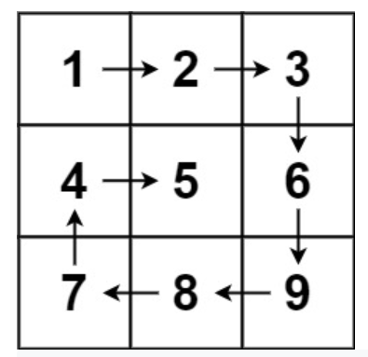
Spiral Matrix Problem

Slide 10
Spiral Matrix Problem

Slide 11
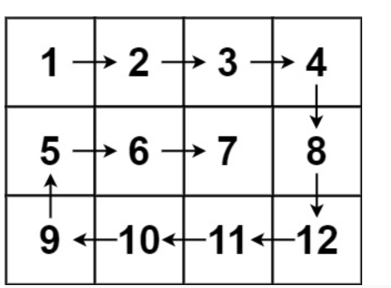
Spiral Matrix Problem

Slide 12
Spiral Matrix Problem

Slide 13
Spiral Matrix Problem

Slide 14
THANK YOU

